Slide 1
Monitoring
Application Monitoring
Notes:
Notes to the Facilitator:
Welcome the participants and give them an overview of the module. Tell them that they will learn about the ‘Infrastructure Monitoring’ in this module.
Notes to the Participants:
You will learn about the Application Monitoring’ in this module.

Slide 2
Module Objective
At the end of this module, you will be able to:
Explain what is application monitoring
Differentiate application and infrastructure monitoring
Describe the components in application monitoring and metrics
Define dependency monitoring
Explain the available tool to do application monitoring
Notes:
Notes to the Facilitator:
Explain the module objectives to the participants.
Notes to the Participants:
You will be informed about the module objectives.
At the end of this module, you will be able to:
Overview of infrastructure monitoring
Difference between application and infrastructure monitoring
Components in Application Monitoring & Metrics
What is Dependency Monitoring
Brief overview of tools available to do application monitoring

Slide 3
Module Topics
This module covers the following topics:
Overview
Application vs infrastructure monitoring
Monitoring components and metrics
Dependency monitoring
Tools overview
Notes:
Notes to the Facilitator:
Inform the participants about the topics that they will be learning in this module.
Notes to the Participants:
You will learn about the following topics in this module:
Overview
Application vs infrastructure monitoring
Monitoring components and metrics
Dependency monitoring
Tools overview

Slide 4
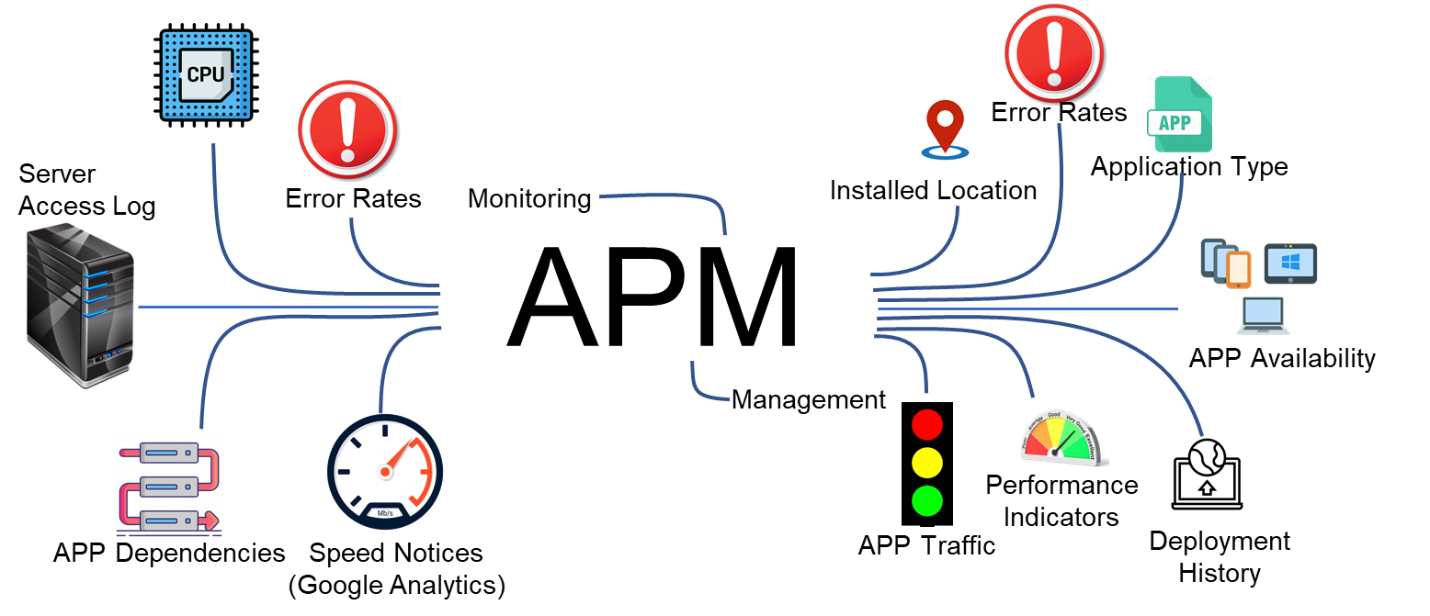
1.1 Overview
The following image depicts the high level diagram of APM.
Notes:
Notes to the Facilitator:
Give an overview of Application Performance Monitoring (APM).
Notes to the Participants:
Application Monitoring is a system, which looks into an application whilst being a part of it for its performance, abnormalities or shortcomings. It routinely looks into an application identifies, analyse and evaluates the performance of an application and also suggest the means to troubleshoot those issues.
Application performance monitoring is a type of monitoring in which the performance of an application is watched to optimize response time, identify errors and exceptions, proper functioning of components and integration. The main goal is to ensure the application is performing well enough to handle client requests/response. With the help of Application Monitoring one can watch whether the application is meeting the performance standards or not. It also helps in identifying bugs and potential risks. An APM solutions provides the insight of resource utilisation in application and how the application is handling requests, which helps in identifying the performance issues before they impact the end user.
Application performance monitoring is often confused with “application performance management”. The AP management is a strategy of managing performance excellence and Monitoring is a part of it.

Slide 5
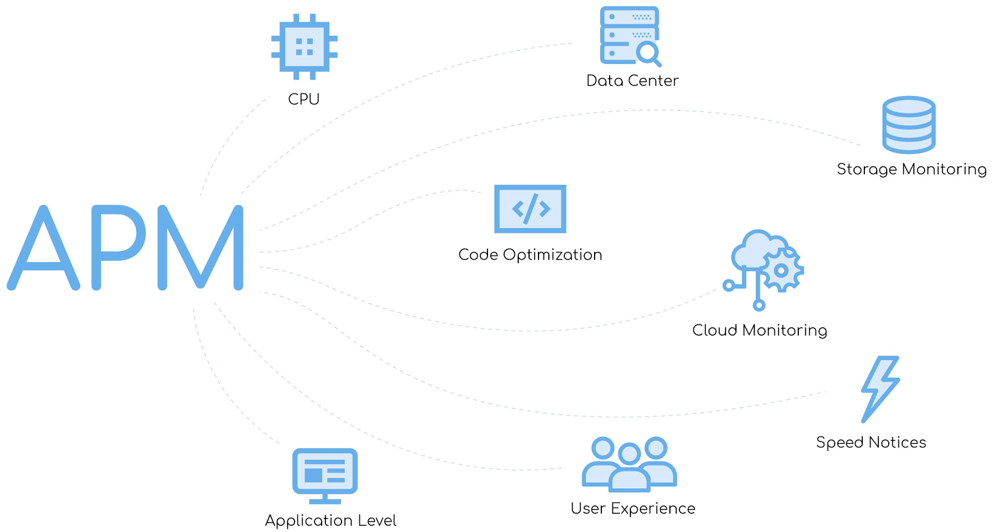
1.2 Why we need APM
To get a proper understanding, let us look the reason behind APM.
Source: https://miro.medium.com/max/6254/1*qC7t8s5dFzBYmp1ypsZJRQ.jpeg
Notes:
Notes to the Facilitator:
Explain the need of application monitoring.
Notes to the Participants:
An Application monitoring is a method, which is needed to ensure that the website or application which is created with immense hardwork and dedication is delivering the business value as it is supposed to be. APM is the IT discipline that focuses on application monitoring and management.
Application monitoring in the lifecycle of a business is critical and requires a fair treatment. So we have listed out some factors, which shows the necessity of Application Monitoring.
Customer Satisfaction
Insight of customer experience
Acumen at every level of application
Digitalisation

Slide 6




1.2 Why We Need APM (Contd…)
We need APM for the following reasons:
Customer Satisfaction
Insight of customer experience
Acumen at every level
Digitalisation
Notes:
Notes to the Facilitator:
Explain the need of application monitoring.
Notes to the Participants:
We need APM for the following reasons:
Customer Satisfaction: Most of the tech organisation are still believer of the idea “if you build it, they will come”. But in this age where every business is getting online, to make an application is not a win it is the easy part. The real hard work begins by building your image among the customer and making them their priority. If the satisfaction of customer is preceded by everything, then they’ll remain trustworthy customer of your product. On the contrary, one of the worst things that could happen for your business is an error prone, buggy site. Nothing will shoo away the potentially paying customers faster than a buggy website, It brings down the trust instantly. So one should take care of health and well being of product ie. application by continuous monitoring with the help of APM.
Insight of customer experience: Application Monitoring can unfold the insights of interaction between humans and applications, experience your mobile apps and websites, with particular emphasis on the correlation between site or app speed (responsiveness) and user satisfaction. With these observations we can explore new ways for you to improve and optimise the performance of your applications and Web resources.
Acumen at every level of application: If an application is running fine, doesn’t necessarily mean that everything is fine. There’s always a chance that the key parts of the application flow are not performing at optimal levels or there is always a chance for scope of improvement. Most of the applications today are complex and there are lots of integration in the moving parts between the frontend, middleware, and backend. Therefore it is very important to understand the behaviour of each application including its components and modules. Every application these days experience from performance issues. Complex infrastructure and integrations that support web application delivery in today’s world makes it even more vulnerable. APM provide a visibility to teams on their application’s performance on every level.
Digitalisation: With the increase in digitalisation the numbers of internet has been drastically increased, and so does the businesses have moved to online. Therefore there is a lot of competition among the businesses, And to keep an edge to your product one must ensure that there is no flaw in the users experience from application side.

Slide 7
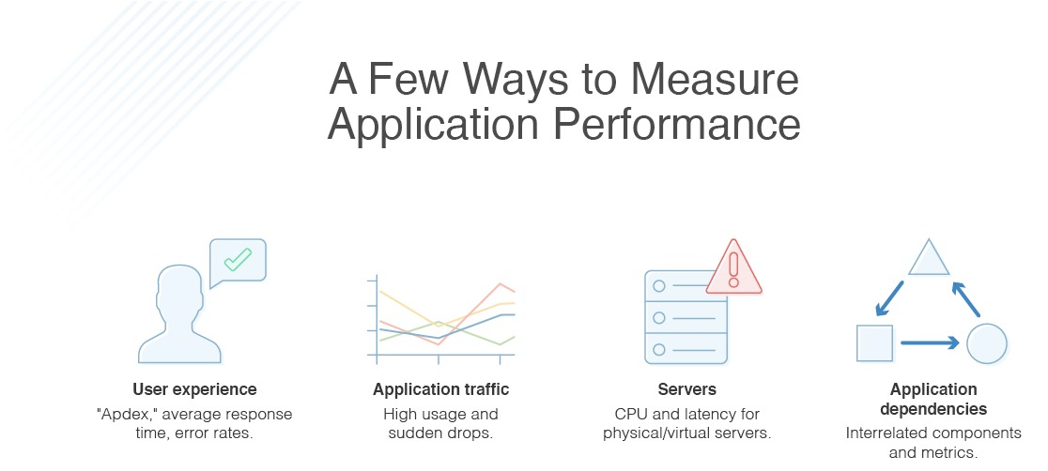
1.3 How to Measure Application Performance
The following image illustrates few ways to measure application performance.
Source: https://www.dnsstuff.com/wp-content/uploads/2020/01/How-to-Measure-Application-Performance.jpg
Notes:
Notes to the Facilitator:
Explain the How to measure Application Performance”.
Notes to the Participants:
Few ways to measure application performance:
User Experience: One of the way is to focus on end-user experience which can provide a lots of insights into the actual impact of system issues. The application performance index, or “Apdex” score, uses an equation to calculate satisfaction, based on fast, sluggish, slow, and failed requests. Similarly, the rate of average response time and error rates are critical for understanding what your end user is actually experiencing when they use an application.
Application traffic: To understand of internet traffic works one needs to get understanding of request rates, or traffic, which can provide insight into performance. W can associate request relates with other metrics to see what happens in duration of high usage. With the help of this one can prepare their application to be ready before any spike in traffic is predicted and prepare for traffic spikes possibly overwhelming servers and networks.
Physical and virtual servers: Another aspect which should be monitored is the foundational aspects of your system your applications depend on, ie analyzing both physical and virtual servers for excessive compute load, low storage, virtual resource allocation, and potential hardware issues. For instance, the following are some key metrics for IOPS throughput for the server, which can reveal latency and connectivity issues:
Logical disk average: disk queuing
Average and maximum IOPS write/read
IOPS latency write/read
IOPS total
Application dependencies: With the growth of multi tier applications most of the apps are now have complex architecture and have may integrations to get an understanding of dependencies between parts of your system is critical for identifying bottlenecks. Dependencies can be revealed through comparing multiple metrics types—like status, events, and statistics— It can be especially useful to see timeline visualizations of your chosen elements.

Slide 8
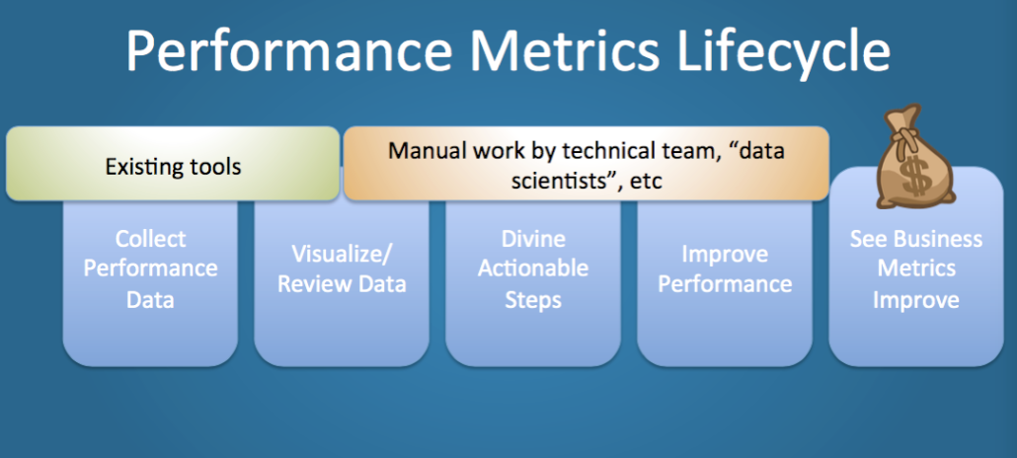
1.4 How do APM Software Works?
The APM tools are typically focussed on these functionalities:
Source: https://rigor.com/wp-content/uploads/2016/02/web-performance-metrics-1030x464.png
Notes:
Notes to the Facilitator:
Explain how application performance monitor works.
Notes to the Participants:
Application performance monitoring software provides administrators the knowledge they need to pinpoint issues, identify root causes, and quickly troubleshoot the situation. Therefore, such tools are immensely useful because they allow us to automate the process and even provide alerts on data. The APM tools are typically focussed on these functionalities:
Protocols
Syslog
Templates

Slide 9



1.5 Key Functionalities
The APM tools are typically focussed on these functionalities:
Protocols
Syslog
SYS Log
Templates
Notes:
Notes to the Facilitator:
Explain the key functionalities of APM to the participants.
Notes to the Participants:
The APM tools are typically focussed on these functionalities:
Protocols: An APM uses several protocols, including UDP, TCP, SNMP, and WMI to gather real-time information about application and infrastructure components. APM monitoring tools typically make API calls to servers to request key data. The best performance metrics are time series-based, because they offer more granular detail for everything from compute to latency and user patterns. The insight into your entire application stack across your network’s servers and app containers is highly important
Syslog: Logging is nothing but the event recorded in the form of log files we can detect and diagnose performance related issues using these event records. These messages can be monitored with monitoring softwares. The sources of log data could be app servers, database servers, hypervisors, firewalls, and more.
Templates: The number of factors required for app monitoring are numerous. This is why templates are designed to pull specific metrics for most commonly used business applications. These predefined templates offer comprehensive performance monitoring from a centralized control panel.

Slide 10
What did You Grasp?
Developers typically use APM tools to track UX metrics like _______, _______and _______.
Error rate, user satisfaction and usability
Net Promoter Score, task success rate and network throughput
User retention, usability and release velocity
Pupil dilation, heart rate and runtime
Notes:
Notes to the Facilitator:
Answer:
A. Error rate, user satisfaction and usability

Slide 11
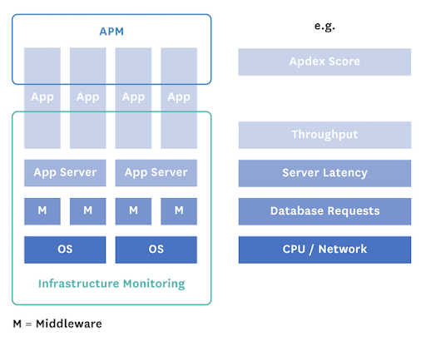
1.6.1 Application vs Infrastructure Monitoring
In this segment, we will compare APM with Infrastructure Monitoring.
Source: https://lh3.googleusercontent.com/proxy/AR3Z881tHc3Y1YqZTDWCG0tVUr5OsEQyKgpzqnr-YAxEq71qReUR4DCX0Y8wsvm3p5s8iyfZf91UrhLrhNUFU8LNPRa7yQTGHeMn7PkX-ssnj9CH5jSGEcRP
Notes:
Notes to the Facilitator:
Explain the APM vs Infrastructure Monitoring to the participants.
Notes to the Participants:
The common thing among the two is that both of the systems want the site to be working properly 24X7, the only difference is of approach which we’ll discuss in detail. let us have view of the difference between them.
Even though there purpose is same but the way they ensure the site availability is extracted among hardware layer and application layer. In Infrastructure monitoring he keyword here is infrastructure, in IT by we mean the platform over which all our applications are hosted, also the other middleware softwares like databases, cache system, cross domain network, and all of our network hardware managed.
Whereas the Application monitoring looks after the health of application irrespective of where it is running. The APM agents keeps an eye on your applications at the code level: they look after for specific things like which transactions, database queries, and external services are taking the most time, what runtime errors are occurring, etc.

Slide 12



1.6.2 Application Monitoring vs APM
The differences between APM and Infrastructure monitoring are:
One vs all
Difference in data
End Goal
Notes:
Notes to the Facilitator:
Explain the APM vs Infrastructure Monitoring to the participants.
Notes to the Participants:
The higher management somewhat consider all monitoring as a whole but they have few parameters which differentiates them. There are three main differences between application performance monitoring and Infrastructure monitoring.
One vs all: Application performance monitoring is monitoring which happens within a specific application. A performance monitoring tool can be used to troubleshoot code-level problems within an application. There are some shortcomings with APM like the incapability of scaling. Hence, it is somehow not practical to have an performance monitoring tool for all applications across platform.
In contrast, Infrastructure monitoring is looking at the whole scope of all servers, middleware softwares like databases, cache system, cross domain network, and all of our network hardwares. An Infrastructure monitoring tool can provide insight into which servers may require maintenance and replacement.
Differences in Data: The data collected between the two methods varies due to the difference in end goals. Infrastructure monitoring has an overall scope of infrastructure. Since this method is focused on health of the hardwares and platform irrespective of application, it takes a look at metrics such as CPU consumption or memory usage. Because of its wide scope of data, Infrastructure monitoring helps identifying the root cause of the impact on resource utilisation or any outage.
End Goal: The end goal of Infrastructure monitoring is to provide a suitable environment to the application for its proper functioning. We can consider infrastructure as a home for applications, databases, other middlewares, and network. To keep all of the components to be healthy the home should be exempted with any flaws or issues. hence, it becomes necessary to have a monitoring system which can tell us about the health of the whole system.

Slide 13
What did You Grasp?
When can an IT organization adopt APM?
In Agile environments
For JavaScript applications
For web applications
For all software applications and development environments
Notes:
Notes to the Facilitator:
Answer:
D. For all software applications & development environments

Slide 14


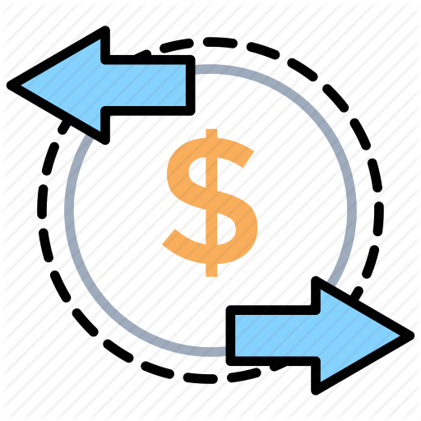
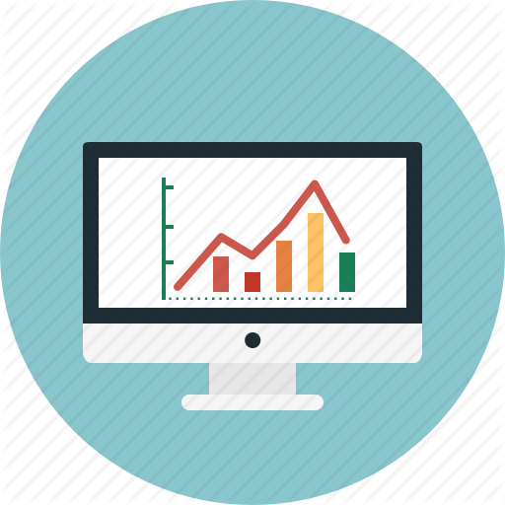
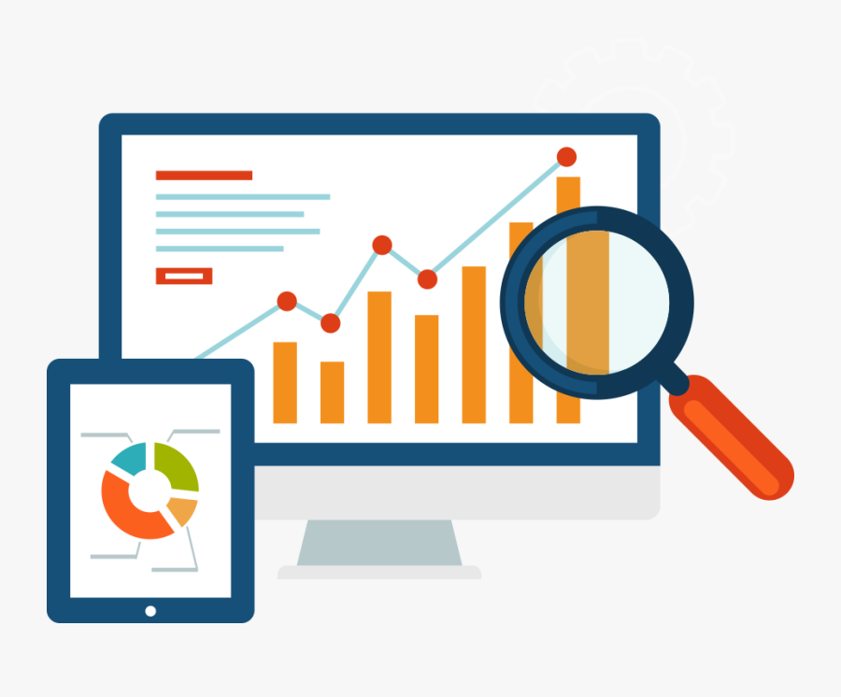
1.7 Monitoring Components
There are few components on which APM focuses:
Runtime application architecture
Real user monitoring
Business transactions
Component Monitoring
Analytics & reporting
Notes:
Notes to the Facilitator:
Explain the various monitoring components to the participants.
Notes to the Participants:
There are few components on which APM focuses:
Runtime application architecture: It is a component which focuses on analyzing the hardware and software components which are being used in the applications execution and their integration parts which required or dependencies. With the help of pattern recognition and the identification of performance issues, Development teams are able to anticipate the potential for future problems before they happen.
Real user monitoring: It is also called end user experience monitoring, which we discussed in previous module in detail it gathers performance data to understand the performance of the application for users and to forecast any potential performance related issues. Real user monitoring helps teams to respond to issues and understand their impact. There are two types of tracking the end user experience:
Synthetic Monitoring: It is a web application monitoring that is done using a Web browser emulation or scripted recordings of web transactions regardless of whether or not users are currently visiting your site.
Agentless Monitoring: It looks into the system via probes to analyze network traffic which travels via network switches and load balancers.
Business transactions: These business transactions focuses on examining specific user interactions and simulate them to test and understand the conditions that lead to a performance problem. is basically using a robot to monitor the end user experience. If you want to use synthetic monitoring, you will have to write to scripts to simulate the user’s actions in your application.
Component Monitoring: It is also considered as application component deep dive, which involves tracking of all components of the infrastructure. In-depth monitoring is performed on all the resources and events within the application performance infrastructure. Which includes the analysis of all servers, operating systems,application components, middleware, and network components.
Analytics & reporting: Once we get all our data via monitoring agents after this it requires translating the data gathered that can be used to define the performance threshold using the pattern of historical and current data which is used to set an expectation for an application to perform. By comparing infrastructure changes to performance changes certain potential areas of improvement can be identified.

Slide 15

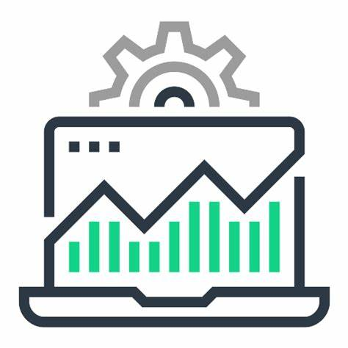
1.8 Monitoring Metrics
The following are the metrics on which APM focuses:
Application time series metrics
Infrastructure metrics
Notes:
Notes to the Facilitator:
Explain the various monitoring components to the participants.
Notes to the Participants:
There are few metrics on which APM focuses:
Runtime application architecture: It is a component which focuses on analyzing the hardware and software components, which are being used in the applications execution and their integration parts which required or dependencies. With the help of pattern recognition and the identification of performance issues, Development teams are able to anticipate the potential for future problems before they happen.
Real user monitoring: It is also called end user experience monitoring, which we discussed in previous module in detail it gathers performance data to understand the performance of the application for users and to forecast any potential performance related issues. Real user monitoring helps teams to respond to issues and understand their impact. There are two types of tracking the end user experience:
Synthetic Monitoring: It is a web application monitoring that is done using a Web browser emulation or scripted recordings of web transactions regardless of whether or not users are currently visiting your site.
Agentless Monitoring: It looks into the system via probes to analyze network traffic which travels via network switches and load balancers.
Business transactions: These business transactions focuses on examining specific user interactions and simulate them to test and understand the conditions that lead to a performance problem. is basically using a robot to monitor the end user experience. If you want to use synthetic monitoring, you will have to write to scripts to simulate the user’s actions in your application.
Component Monitoring: It is also considered as application component deep dive, which involves tracking of all components of the infrastructure. In-depth monitoring is performed on all the resources and events within the application performance infrastructure. Which includes the analysis of all servers, operating systems,application components, middleware, and network components.
Analytics & reporting: Once we get all our data via monitoring agents after this it requires translating the data gathered that can be used to define the performance threshold using the pattern of historical and current data which is used to set an expectation for an application to perform. By comparing infrastructure changes to performance changes certain potential areas of improvement can be identified.
Application time series metrics: Error rates, requests per minute, average response times, etc. are examples of application time-series metrics. These metrics are collected over a long period and with their analysis, teams can identify recurrent patterns and outliers. The analysis helps in predicting future server capacity requirements. Unlike logs and infrastructure metrics, which help in deeper troubleshooting, the primary use of time-series data is limited to the detection of trends and potential issues.
Infrastructure metrics: As discussed above, server monitoring software helps to capture infrastructure metrics such as CPU and memory consumption, disk I/O, network I/O, and more. By tracking these metrics, teams can identify if their resources are going to peak or have excess capacity. Further, admins can set up threshold-based alerts using these metrics to prevent load shedding and failures.

Slide 16
What did You Grasp?
Which parameter(s) APM looks after?
Web performance monitoring
Application availability and uptime
Request rates
All of the above
Notes:
Notes to the Facilitator:
Answer:
D. All of the above

Slide 17
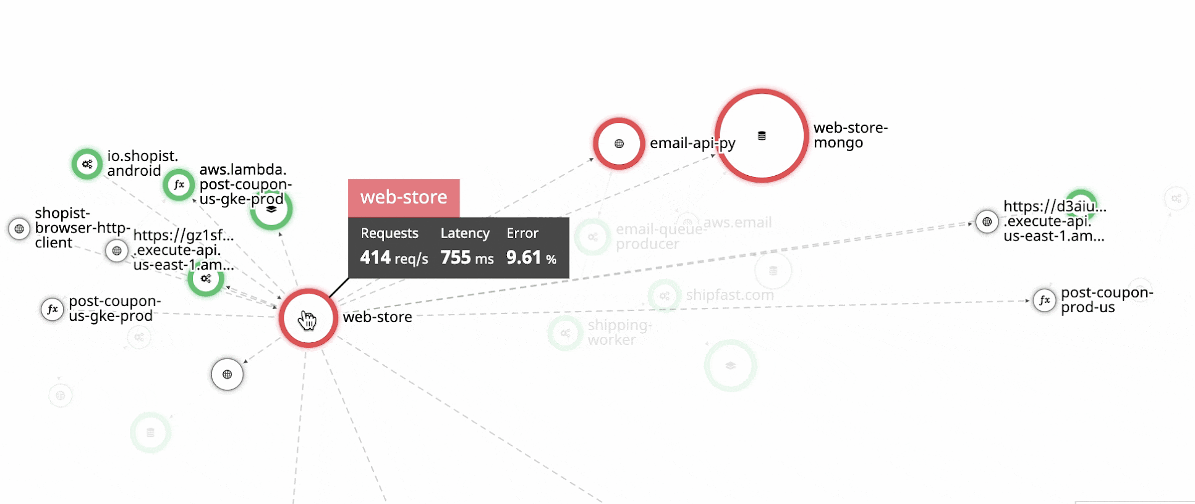
1.9 Dependency Monitoring
The following image shows an example of dependency in application, and its monitoring.
Source: https://lh3.googleusercontent.com/proxy/AR3Z881tHc3Y1YqZTDWCG0tVUr5OsEQyKgpzqnr-YAxEq71qReUR4DCX0Y8wsvm3p5s8iyfZf91UrhLrhNUFU8LNPRa7yQTGHeMn7PkX-ssnj9CH5jSGEcRP
Notes:
Notes to the Facilitator:
Explain the Dependency monitoring to the participants.
Notes to the Participants:
Let us discuss what is dependency in application, we can say that an application dependency is a list of applications that are required for this application to work properly. For example, dependency usually listed inside of the Application details inside of Objects > Applications > application detail window. Since these loosely coupled components are interdependent for proper functioning of entire application. Hence the monitoring of dependency application becomes important.
To understand 100% of the inter-dependencies between processes and services across multiple hosts, an APN needs to monitor network traffic and communications. In today’s day and age cloud topologies have literally millions of dependencies changing on the go. It's much more than human capability. Only Automated or AI-powered full-stack, real-time auto-detection can keep up with this requirement.

Slide 18
What did You Grasp?
Select the term that best matches the description: This term refers to the evaluation of event data that the organization captures from the software, network or component in the IT ecosystem. Analysis of this event data reveals patterns in areas like user behavior, compliance and security, as well as performance problems.
Flow mapping
Real-user monitoring
Log monitoring
Root cause analysis
Notes:
Notes to the Facilitator:
Answer:
B. Real user monitoring

Slide 19
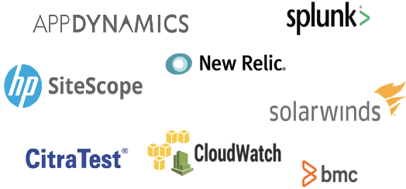
1.10 Tools Overview
The following are some prominent application monitoring tools:
Notes:
Notes to the Facilitator:
Explain the Application Monitoring Tools to the participants.
Notes to the Participants:
AppDynamics
Splunk
SiteScope
New Relic
Citra Test
Cloudwatch
BMC
Solar Winds

Slide 20
What did You Grasp?
An APM system should reveal what performance information?
Conversion rate, uptime, ROI
Runtime, error rates, CPU usage, application availability, response time
Load tests, stress tests, spike tests, soak tests
B or C
Notes:
Notes to the Facilitator:
Answer:
D. B & C

Slide 21
In a Nutshell
In this module, you learnt:
Overview of application monitoring
Difference between application and infrastructure monitoring
Components in application monitoring and metrics
What is dependency monitoring
Brief overview of tools available to do application monitoring
Notes:
Notes to the Facilitator:
Share the module summary with the audience.
Ask the participants if they have any questions. They can ask their queries by raising their hands.
Notes to the Participants:
Now, you have reached the end of the module, In this module, you learnt:
Overview of Application monitoring
Difference between application and infrastructure monitoring
Components in Application Monitoring & Metrics
What is Dependency Monitoring
Brief overview of tools available to do application monitoring

Slide 22
Next Module 5: Log Monitoring and Analysis

